Slide 1

Planning & Budgeting
24th August 2011
Dave Hastings

Slide 2
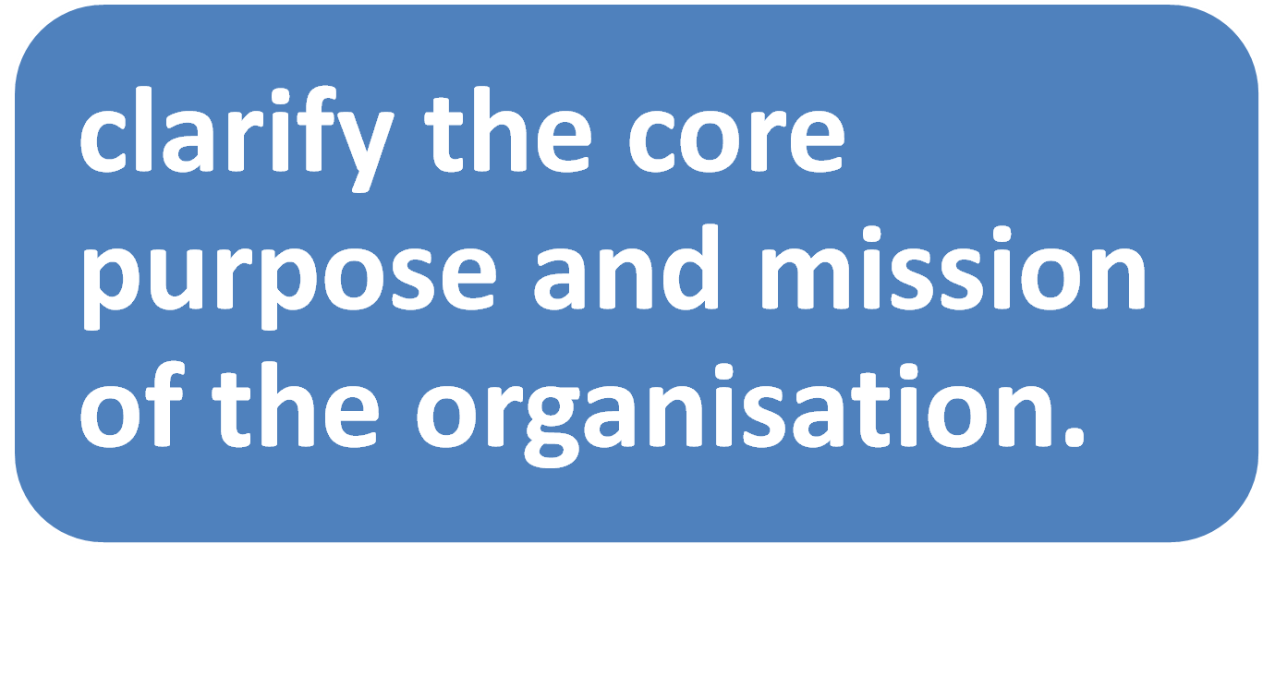

Stage 1

Slide 3
Mission and Values
ensure that there is a clear sense of direction
agreement about the core values
Seek the views of
  Committee
  Members
  Staff
  Volunteers
  Funders

Slide 4
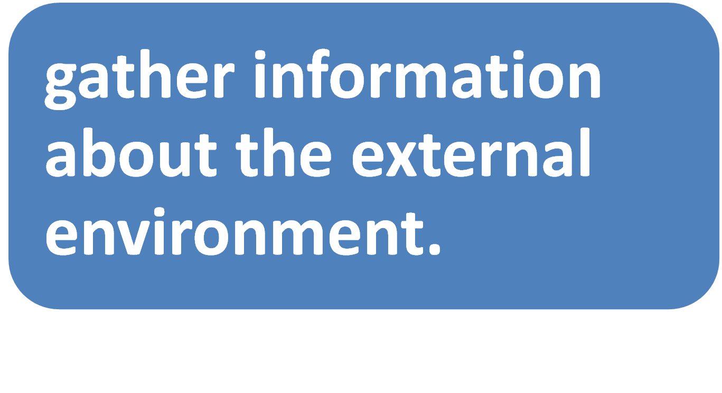
Stage 2

Slide 5
The world around your organisation
Political
Economic
Social / cultural
Technological
Legal
Environmental
PESTLE

Slide 6
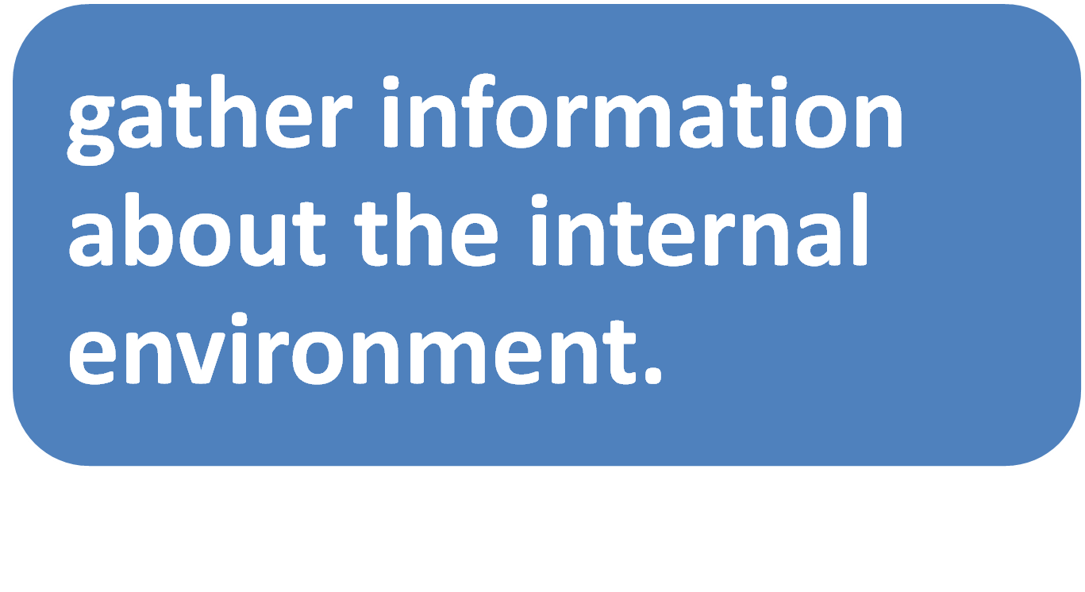
Stage 3

Slide 7
The current activities of the organisation
Culture and philosophy
Finances
Management
Structure
Operations

Slide 8
SWOT Analysis
Strengths
Weaknesses
Opportunities
Threats

Slide 9
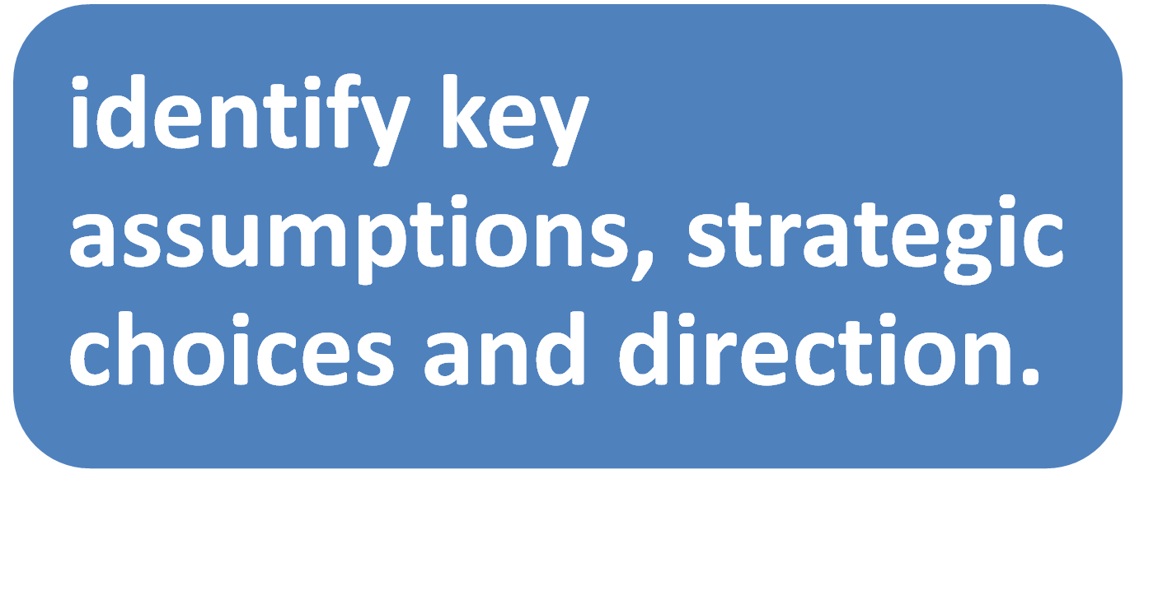
Stage 4

Slide 10
Choices
What will be your overall direction?
What will be your priorities?
What will you stop doing?

Slide 11
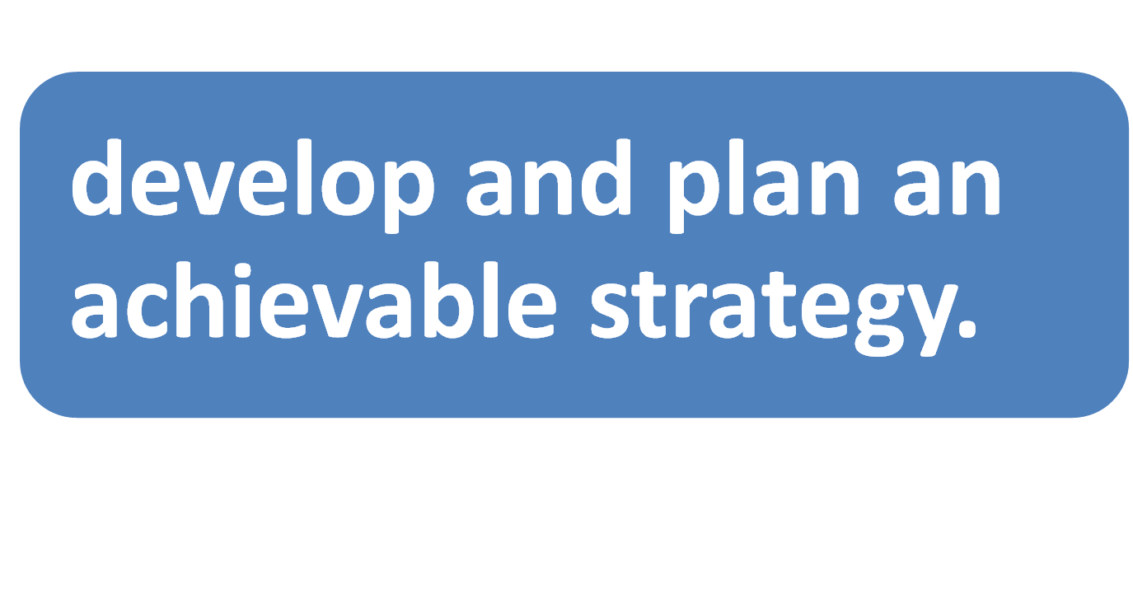
Stage 5

Slide 12
A Coherent Plan
Realistic and achievable
Specific actions
What are your objectives
What is the time frame?
How will you measure success?

Slide 13
Setting Objectives
All objectives must be SMART.
Specific - what exactly do you want to achieve?
Measurable – what difference will it make?
Achievable - is what you propose possible?
Relevant - does it fit into the wider context?
Time based - how long will it take?

Slide 14
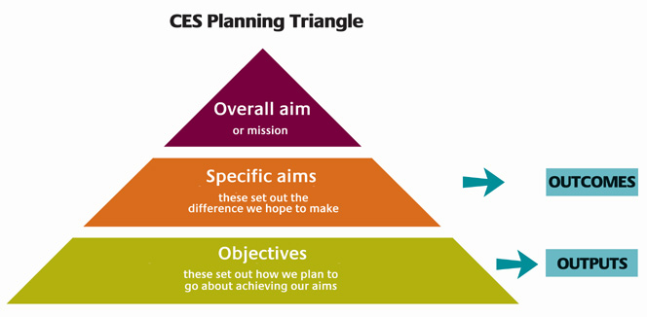

Planning – an overview

Slide 15
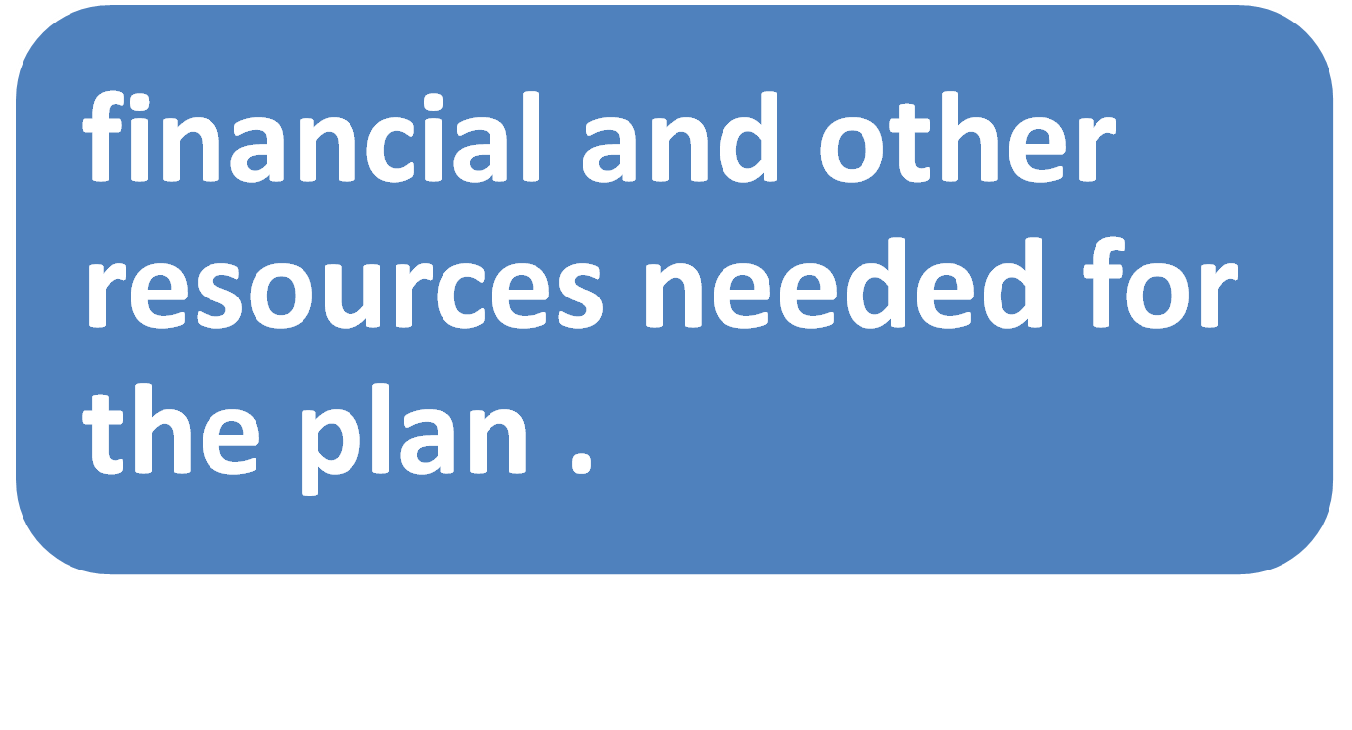
Stage 6

Slide 16
Aims - objectives - budget
The organisation has an overall aim or mission
There are specific aims that set out the difference the organisation hopes to make
  These differences are OUTCOMES
Specific objectives set out how the aims are to be achieved
  the objectives require activities that produce OUTPUTS
  The resources needed for each activity can be quantified in a BUDGET

Slide 17
Identify Inputs
What do we need to have in order to make this plan work?
Staff
Materials
Space
Time
Include everything (100% rule)

Slide 18
Make Assumptions
How many staff?
How much space?
How many users?
How long will the project run for?
How many hours per weeK
Etc.

Slide 19
Types of cost
Fixed costs
Variable Costs
Project / direct costs
Overheads / indirect costs
Capital costs
Start up costs
Capital Costs
Revenue Costs

Slide 20
Key Tips
Be reasonable
Be prudent
Be realistic
Be consistent.

Slide 21

Stage 7

Slide 22
Monitoring
Business planning is an ongoing process.
Monitor
Evaluate
Review

